Slide 1
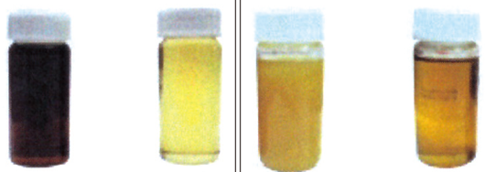
Waste Oil Refinery Project
Investing in business in KOREA
Oil Refinery Results
GET. Co LTD

Slide 2
Oil Refinery Business
Investing in Business in KOREA
Basic Plan
Establishing a master plan – Korean market
Korean Market Research and Competitive Analysis:
Market price and size of renewable oil
- If the number of industrial production facilities increases, it will increase even more. We plan the business with a monthly scale of 300 tons that we can secure.
Product acquisition cost (market price): ￦200k/ton (1,000 liter)
Sales price after recycling (market price): ￦1,000k/ton (1,000 liter)
Additional cost of recycling facility (excluding facility investment cost): ￦500M
Korean market price: (￦-200k/ton, [industrial waste disposal cost]): Processed at ￦0/ton to secure quantity.
Unit price of production materials (waste oil): ￦500k/ton
A market where 1,500 to 2,000 tons can be recruited per month.
2) Analysis of waste oil treatment methods
In Korea, it is classified as industrial waste, so the generator must bear the cost of reprocessing, and must report the movement path and reprocessing situation of the waste to the government in real time.
It cannot be directly incinerated or reused without reprocessing.
Any method that may cause environmental pollution cannot be reprocessed without government approval, and only licensed companies can reprocess it.
Therefore, in Korea, collection companies like this project receive both waste oil and processing costs, so the profit structure is good.
However, this waste oil reprocessing business is also highly competitive, so there is a problem with securing volume, and as a way to secure this, we plan to receive only waste oil free of charge without receiving reprocessing costs.- In Korea, the government promotes waste oil reprocessing as a business that can increase added value and solve environmental problems at the same time.
By regenerating waste oils, we can solve reuse and environmental problems at the same time (95% or more of the prototype quality). The initial regeneration is 10 tons/day (10 hours of work), and the goal is to process 250 tons/month by working 25 days/month.
The initial regeneration is 10 tons/day (10 hours of work), and the goal is to process 250 tons/month by working 25 days/month.
The production volume will be gradually increased every month.
3. Securing production facilities and equipment :
The current waste oil reprocessing facility capacity will be expanded to 1 ton/hour.
The project will be carried out using new technologies at a factory that has already received government approval.
The profits from the operation of the factory are divided 50:50 between the producer and the investor, excluding expenses.
The patent usage fee for the patented technology is used for the purpose of joint business, so it is carried out without separate payment.
Planning for personnel organization and technician operation :
The personnel and organization for production, sales, marketing, etc. will be operated by the Korean side.
The personnel required for on-site production will be dispatched from Bangladesh to operate the factory, and this can be discussed in the future.
The Korean Labor Standards Act will be applied to the dispatched personnel in Bangladesh, and production technology for the future will be shared.
- While the production facility is being reworked, personnel will be deployed in advance for about a month to receive technology transfer, and the cost of living during the technology transfer period will be borne by Bangladesh.
Production and operation schedule and process plan.
2. Setting product lines and specifications :
Processing is possible for all waste oils.
By regenerating waste oils, we can solve reuse and environmental problems at the same time (95% or more of the prototype quality). The initial regeneration is 10 tons/day (10 hours of work),

Slide 3
Oil Refinery Business
Investing in Business in KOREA
Establishing a master plan – Korean market
Marketing and sales strategies :
Establish a product acquisition strategy.
- Secure only waste oil free of charge without receiving industrial waste disposal costs.
- Maintain quality of 95% or more compared to new oil quality.
- Provide products that meet customer needs quickly.
Distribution channel and sales strategy decision.
- Attract customers by securing waste oil, focusing on large companies that generate a lot of waste oil.
- Attract customers by securing waste oil, focusing on large companies that generate a lot of waste oil.
- Ensure sufficient profits for distributors with reasonable sales prices.
- Encourage government policies to be aligned with RE100 conditions.
Investment feasibility review through expected profit and profitability analysis: Active investment
- Investment cost can be recovered within at least 12 months
If the initial investment cost is repaid in 12 installments, net profit is expected to be converted from 1 year after the start of the business
A. Summary of oil handling volumes.
No | Items | Base | Note
1 | Working Hours/Day | 10
2 | Working Days/month | 25
3 | Processing Products(Ton/month) | 250
B. Regeneration and processing costs.
No | Items | Base | Amount | Note
4 | Processing costs. (\/ton) | 600 | \150,000
5 | Selling costs. (\/ton) | 1000 | \250,000
6 | Sales revenue. (\/ton) | 400 | \100,000
Financial Planning and Budgeting :
Initial investment cost and operating capital plan: ￦500,000k.
- Including plant facility expansion and preparation costs..
Profitability analysis and investment return expectation setting: Refer to business balance sheet.
10. Cost and profitability analysis :
Production and operating cost forecast: Annual return on investment (guaranteed to be 100% or more)
- Market price needs to be evaluated regularly
The appearance of the business
As a result, it utilizes waste oil recycling technology (equipment),
it is a facility business that regenerates collected waste oil into a reusable form,
and sells it to generate profits.
11. Risk Management and Response :
Establishment of a stable supply of waste oil in the Korean market
- ​​No-compensation purchase strategy in the market
(Korean industrial waste disposal cost: -￦200,000).
- Strategy to secure market share compared to other companies by securing new technology (patent) for waste oil.
- Establishment of a high-price purchase strategy with sufficient competitiveness.
2) Establishment of resale power of recycled products
- Maintaining high quality of recycled products (95% or more compared to normal refined oil).
- - Direct investment in new renewable energy power generation business with eco-friendly products (expansion business).
8. Capital Investment and Funding Plan:
Determine the amount of capital investment required: Recruit investors
Funding method and funding period plan: 1Month
9. Cost and profitability analysis :
Production and operating cost forecast: Annual return on investment (guaranteed to be 100% or more)
- Market price needs to be evaluated regularly

Slide 4
Oil Refinery Business
Investing in Business in KOREA
Basic Plan
I. Initial Investment and Operating Costs

Slide 5
Oil Refinery Business
Investing in Business in KOREA
Investment plan.
II. 24-Month Installment Repayment Method(For investment)
III. Only repay investment interest

Slide 6
Oil Refinery Business
Investing in Business in KOREA
Investment plan.
IV. The entire net profit is repaid first to the investment cost.
* The full investment recovery period is up to 13.3 months.

Slide 7
Oil Refinery Business
Investing in Business in KOREA
Production plan
Production facility installation plan
Invest in the expansion of facilities of a company with original technology for waste oil regeneration (profit distribution)
Invest in a company with original technology for the latest waste oil regeneration for the purpose of expanding regeneration facilities and acquire shares..
Dispatch production personnel to secure technology and enhance labor productivity.
Check the progress of the business periodically after investing the cost.
The expansion of facilities will be completed within 8 months after the investment.
There will be a 3-month test run period from the initial production to the normal production point.
After the start of the business, normal operation will be confirmed and the purchase cost will be settled and paid.
Royalty payment for use of regeneration technology.
Royalty incurred while operating the facility is processed within the producer distribution without separate payment.
Normal operation of regeneration facility.
The period for securing productivity and securing the market is set to 3 months, and production volume is gradually expanded to enable normal operation.
Before normal production, operating costs and personnel are secured, and production personnel are secured during the facility expansion, and operating technology is transferred.
The cost of securing waste oil should be calculated in scale by reflecting the period according to the market's cash flow.

Slide 8
Oil Refinery Business
Production plan & Market analysis
1. Product Lineup: Production Plan
Product Lineup
Products are classified according to the grade of waste oil regeneration.
- Additives according to regeneration are supplied from Korea.
- Production of waste oil regeneration products (engine oil and lubricant)
Market Analysis:
1) Market Size and Growth Prospects:
As Korea's high growth leads to the strengthening of waste oil policy and the reinforcement of the Re100 policy, competitiveness is expected to be strengthened with the new technology.
If the limit is reached in Korea, a strategy to expand the scope of business overseas (Bangladesh) is necessary.
2) Understanding the market competition structure:
As waste oil management becomes stricter, the total amount of emissions will increase, and the recycling industry is expected to expand its market.
3) Research on technology and innovation trends:
Only reliable and perfect recycling technology will dominate the market.
Secure a stable market by being recognized as a new renewable technology (NET/NEP)
4) SWOT Analysis:
Understanding the company's own market position through analysis of its strengths/weaknesses, opportunities, and risks.
Competitive Analysis:
1) Market Entry Barriers Analysis:
Stable waste oil acquisition strategy in the existing waste oil market.
Analyzing the difficulty and possibility of market entry by considering technical, legal, and financial factors.
2) Future Strategy and Outlook:
Establishing future competitive strategies by predicting market competition trends.
3) Differentiation Strategy Analysis:
- Establish strategies to secure unique values ​​and advantages that can be provided to customers.
4) Marketing and Sales Strategy Development:
Establish marketing strategies that utilize the weaknesses of competitors by identifying them.
Establish business strategies that differentiate from competition through the company's engine generators.
Competitiveness Securing Stage
- Establish a stable waste oil supply method from waste oil suppliers through a strategy to secure expensive waste oil compared to other companies.
- Secure customers for high-quality recycled oil.
- Install a self-engine generator using recycled oil to secure a continuous and stable sales channel..
Market Dominance Stage
Establish a policy to expand and support the waste oil recycling industry from the government.
Induce the RE100 policy to be established under government leadership, and make the waste oil recycling business an essential government policy.

Slide 9
Renewable fuel oil manufacturing technology using microemulsion process technology
Outdoor waste oil tank storage: Waste oil is stored through a company that has a collection agreement with our company.
1st additive mixing process: Transfer to the container by pump through pipe.
Bio-surfactant mixing process: Using 98% bio-additives extracted from plants.
Activation of biodegradation function using mineral functional water, reduction of heavy metals, deodorization process : Room temperature operation.
Add nonionic bio-surfactant (98% BOI biodegradation) liquid raw material and mineral functional water to waste oil at room temperature, mix, and stir for 30 minutes.
Through this process, the biodegradation function of substances contained in waste oil is activated, and through this, oil viscosity is improved and the separation and reduction of hazardous substances are stabilized.
: Attached is a test certificate for the results of the use and application of additives (2 types of raw materials) (May 27, 2024)
- Test contents: Tested by requesting KTR (Korea Testing & Research Institute for Chemical Industry)
- Test on the treated material using our mineral bio-functional water for crude oil sludge (overseas crude oil waste process request sample)
- After the test cleaning work, the results of removing heavy metals and the characteristic coagulant “acrylamide” are attached (liquid wastewater and split test results after crude oil sludge cleaning)
Transfer of waste oil mixed with the first additive to the oil-water separator process equipment: pump transfer method through pipes.
Secondary oil-water separation process using a heating source (80~150 degrees Celsius)
- Oil, moisture, and sludge separation process work after the first process.
Three oil-water separator heating processes are performed to separate harmful substances and remove moisture contained in waste oil.
- Separate and reduce odors, heavy metals, and pollutants by utilizing vapor (liquid) or gaseous volatile organic compounds that may be generated in the process.
Process for separating and precipitating a small amount of fine powder (particles the size of flour) sludge contained in waste oil.
- During the oil-water separation process, a small amount of fine powder (particles the size of flour) sludge on the floor inside the facility is filled into a 20KG sealed plastic container and disposed of by a designated waste disposal company.
(The amount of solid fine powder (particles the size of flour) sludge is expected to be around 0.2%)
< Processing process >
Sedimentation (sludge, heavy metal removal)
Additives (biosurfactant)
Waste Oil Collection and Storage
Biodegradation and viscosity improvementReduction of hazardous substances
Second additive (bioelastomer surfactant)
Heavy metal removal and toxicity reduction
Oil/water separation(Heating 80~150℃)
Oil/Moisture, Sludge
Regeneration oil extraction (heating 80~150℃))
Storage and resale of recycled oil
Heavy metals(~3%)
Sludge (0.2%)
Regeneration oil.(Over 95%)

Slide 10
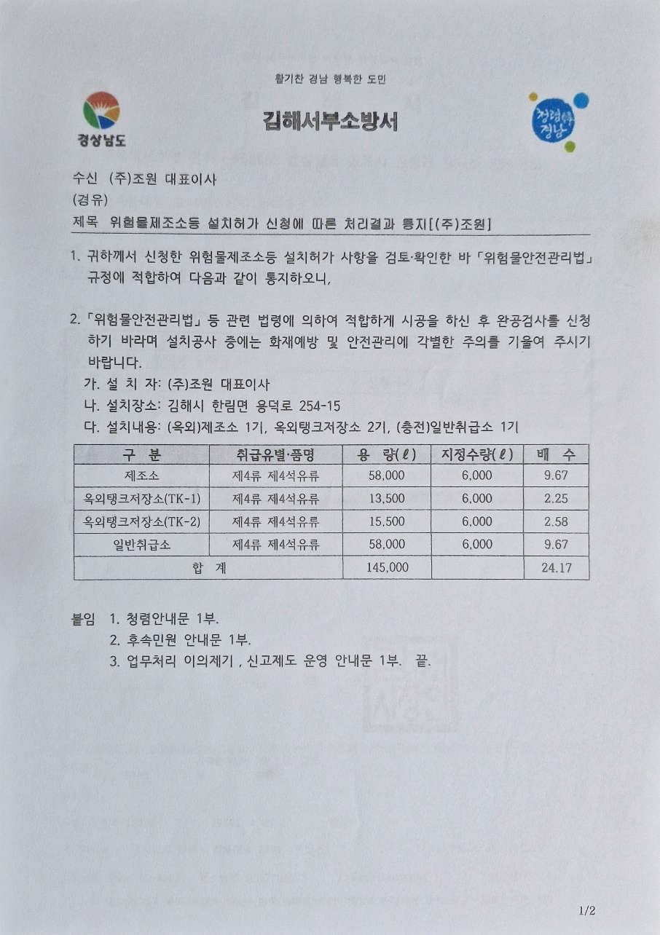
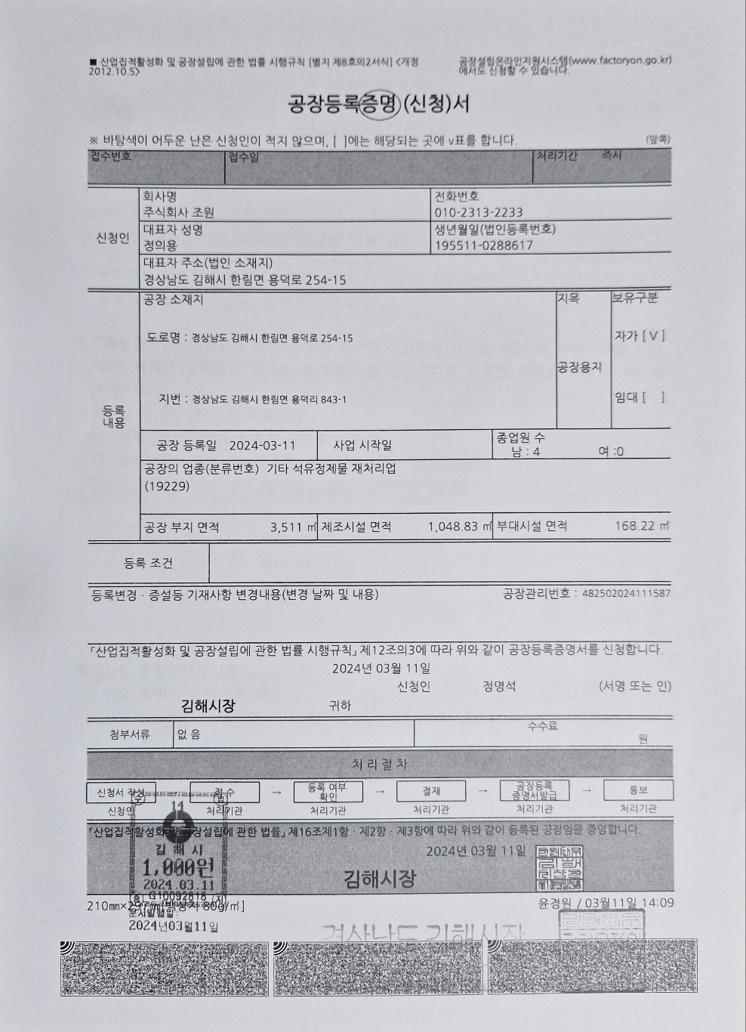
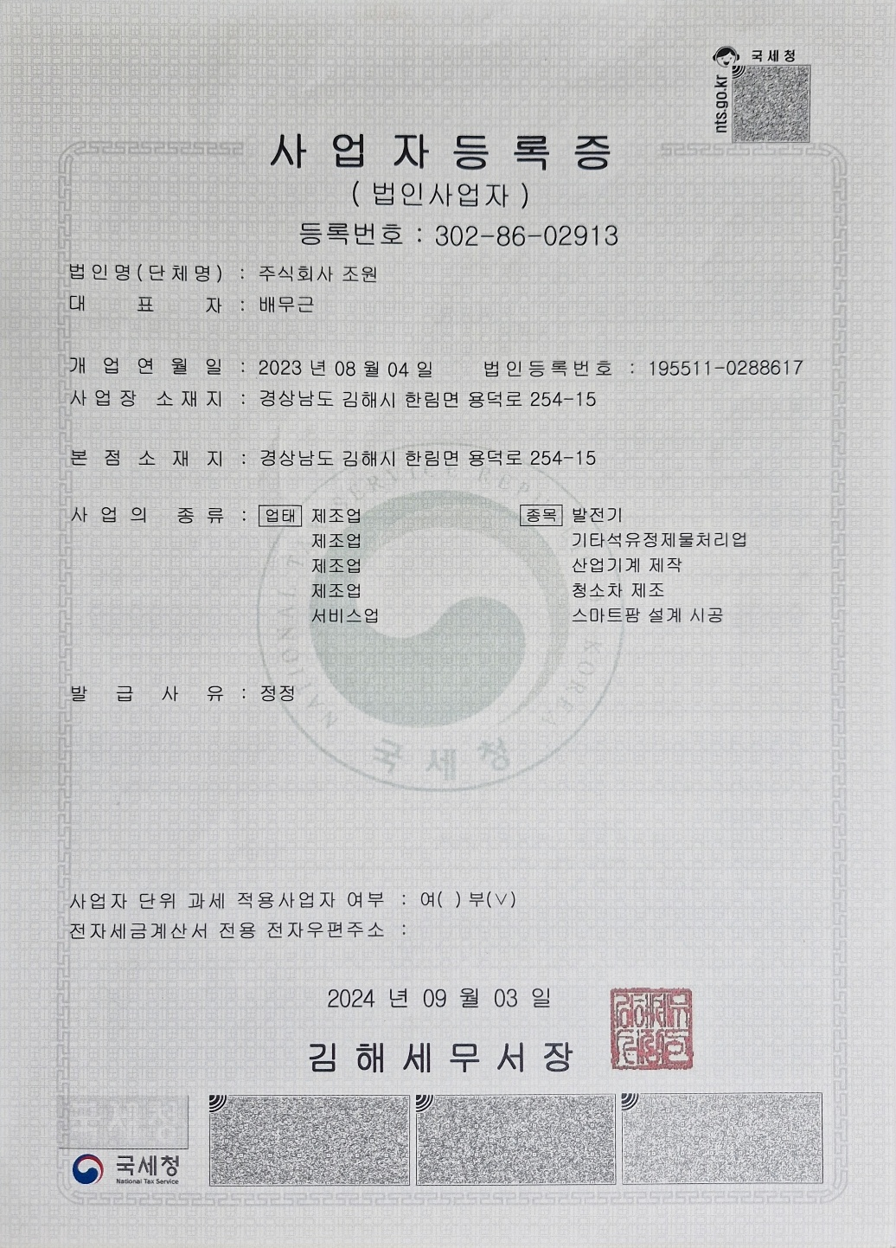
Application for permit for disposal of hazardous materials (waste oil)
Factory registration certificate
Business registration certificate
Title: Notice of processing results for application for installation permit for hazardous materials manufacturing facility, etc. [JoWon Co.LTD].
Business registration certificate
: Method for purifying waste operating oil using silica gel and purification device using the same.
Category | By type of handling - Item | Capacity | Designated quantity | Multiple.
Manufacturing facility | Class 4 - Class 4 petroleum. | 58,000 | 6,000 | 9.67
Outdoor tank storage (TK-1). | Class 4 - Class 4 petroleum. | 13,500 | 6,000 | 2.25
Outdoor tank storage (TK-2) | Class 4 - Class 4 petroleum. | 15,500 | 6,000 | 2.58
General handling facility | Class 4 - Class 4 petroleum. | 58,000 | 6,000 | 9.67
Total |  | 145,000 |  | 24.17

Slide 11
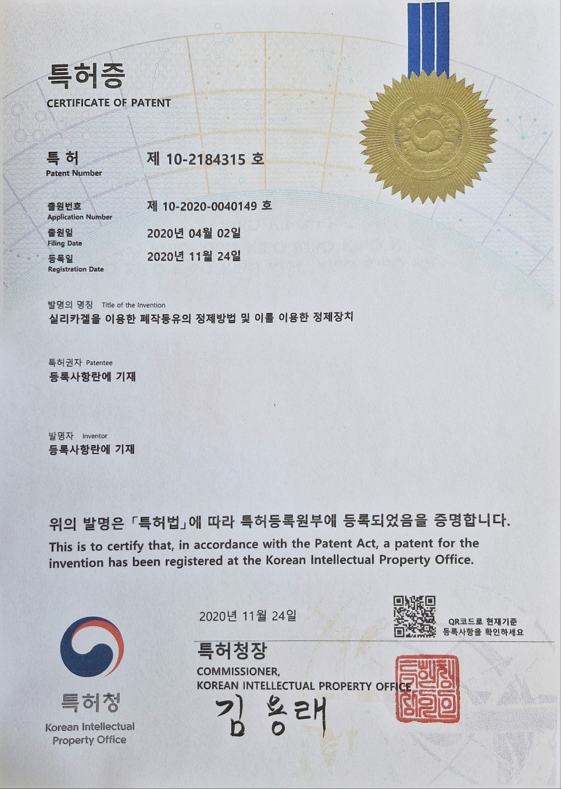
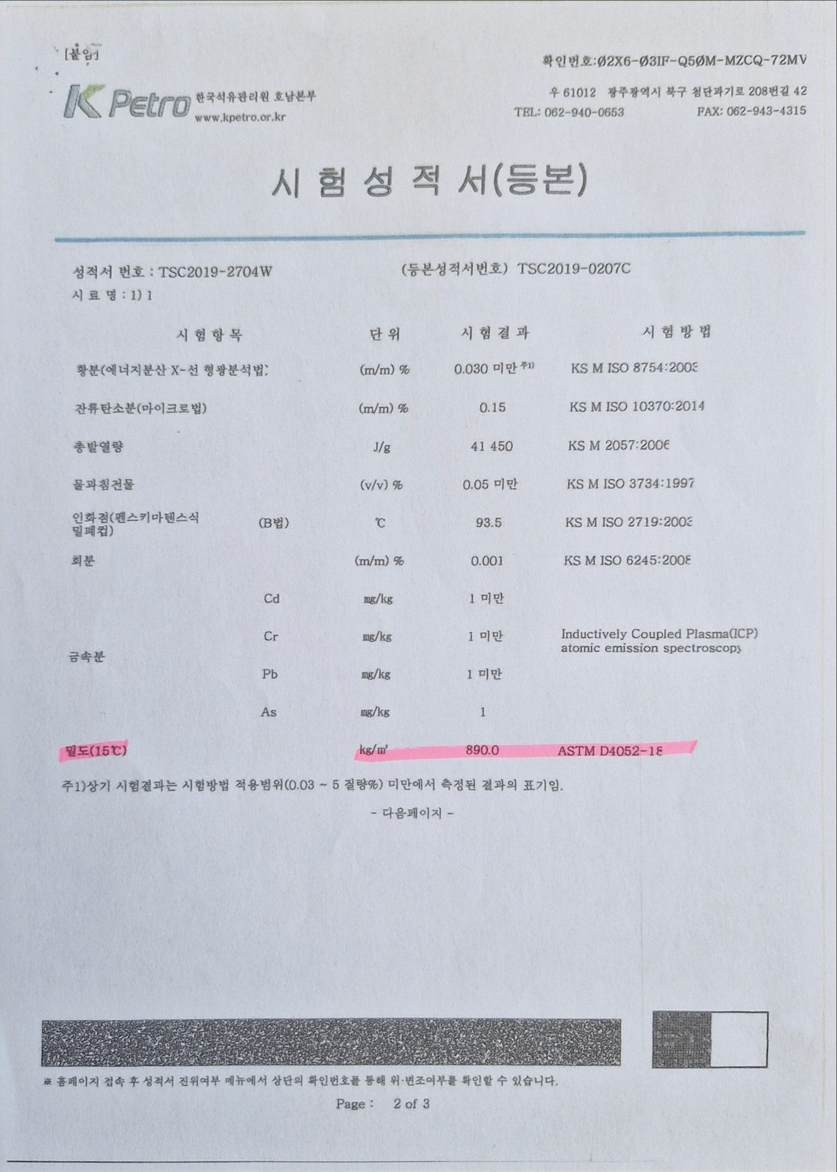
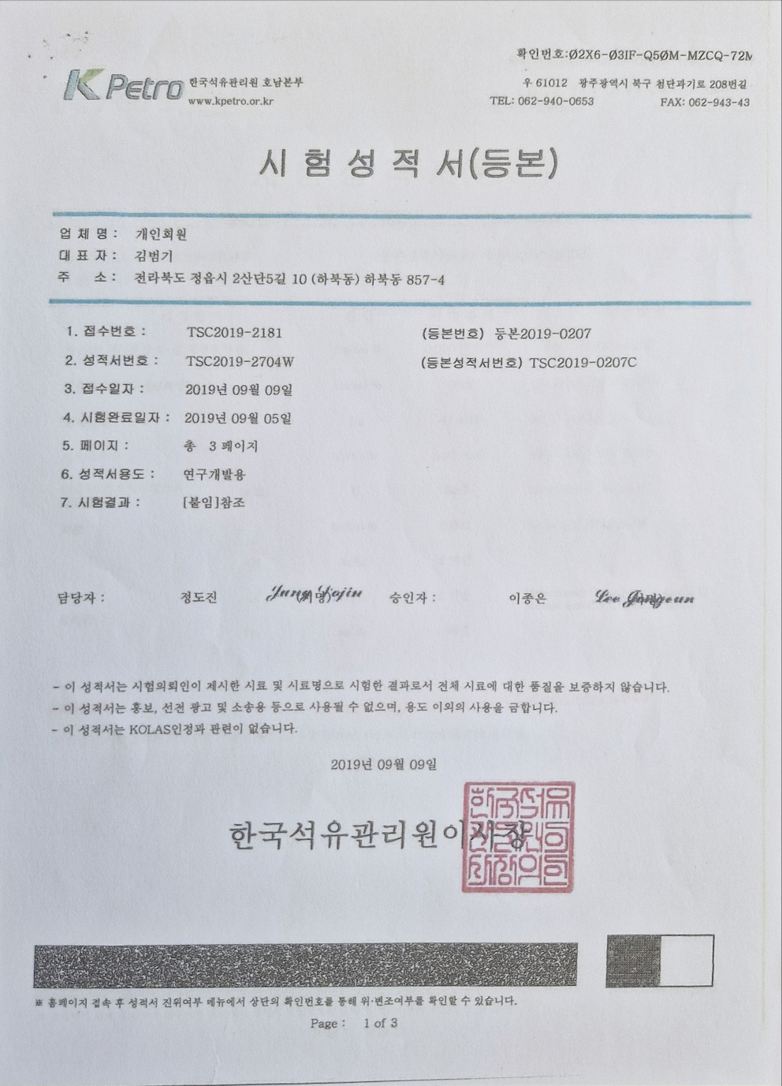
Test Report: Tested by KTR
Test Report: Tested by KTR
Certificate of Patent (특허증)
Test report of waste treatment results using patented method : Suitable.
=> Tested by KTR
: Method for purifying waste operating oil using silica gel and purification device using the same.

